Slide 1
Sorting Algorithms Lecture 7

Slide 2
Cocktail/Shaker/Bidirectional Bubble Sort
Shaker sort (cocktail sort, shake sort) is a stable sorting algorithm
Shaker sort is a bidirectional version of bubble sort

Slide 3
Cocktail/Shaker/Bidirectional Bubble Sort
Each iteration of the algorithm is broken up into two stages:
The first stage loops through the data set from bottom to top, just like the Bubble Sort. During the loop, adjacent items are compared. If at any point the value on the left is greater than the value on the right, the items are swapped. At the end of the first iteration, the largest number will reside at the end of the set
The second stage loops through the data set in the opposite direction – starting from the item just before the most recently sorted item, and moving back towards the start of the list. Again, adjacent items are swapped if required

Slide 5
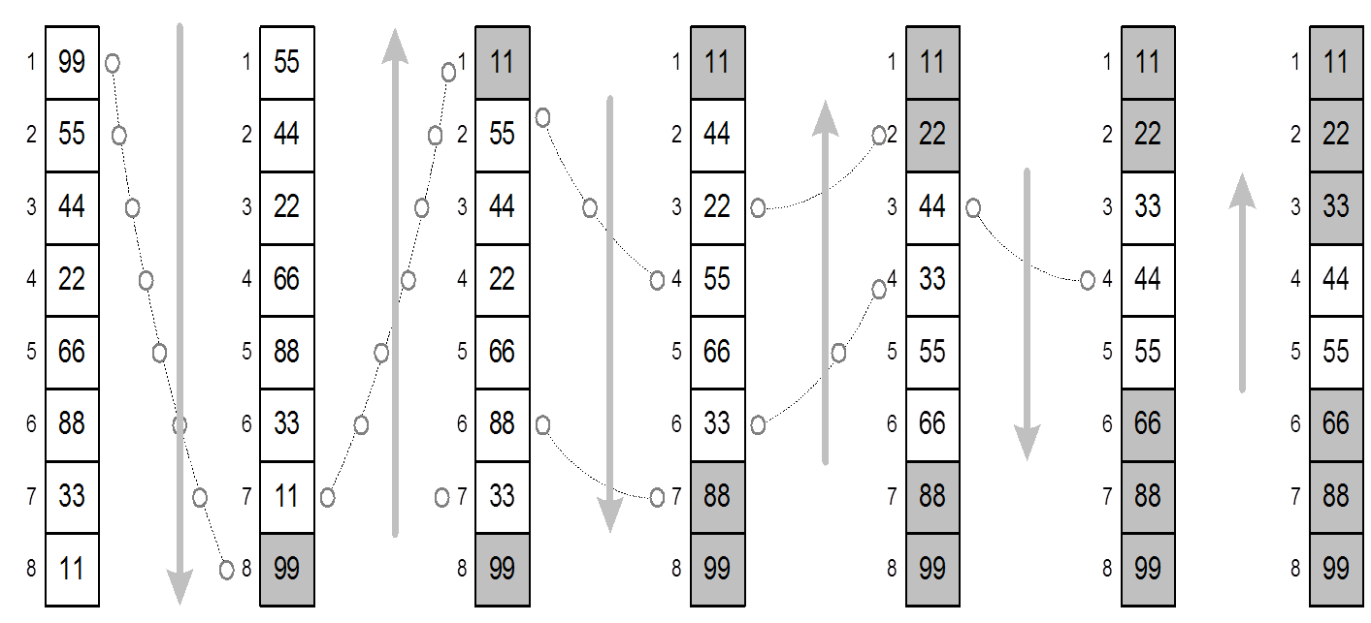
Cocktail Sort Example 1

Slide 6

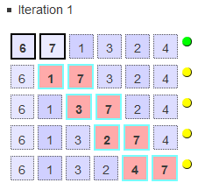
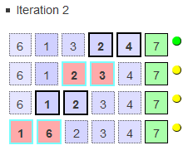
Cocktail Sort Example 2
Sorting the list 6, 7, 1, 3, 2, 4:
Pass 1:

Slide 7
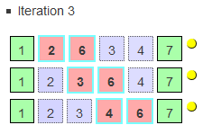
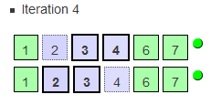
Cocktail Sort Example 2
Pass 2:

Slide 8
Cocktail Sort (Program)
static void CocktailSortBasic(int[] dataSet)
{
bool swapped = false;
int start = 0;
int end = dataSet.Length - 1;
do
{
// make sure we reset the swapped flag on entering the loop, because it might be true from a previous iteration.
swapped = false;
// loop from bottom to top just like we do with the bubble sort
for (int i = start; i < end; ++i)
{
if (dataSet[i] > dataSet[i + 1])
{
Swap(dataSet, i, i + 1);
swapped = true;
}
}
// if nothing moved, then we're sorted.
if (!swapped)
{
break;
}

Slide 9
Cocktail Sort (Program)
// otherwise, reset the swapped flag so that it can be used in the next stage
swapped = false;
//move the end point back by one, because we know that the item at the end is in its rightful spot
--end;
// this time we loop from top to bottom, doing the same comparison as in the previous stage
for (int i = end - 1; i >= start; --i)
{
if (dataSet[i] > dataSet[i + 1])
{
Swap(dataSet, i, i + 1);
swapped = true;
}
}
/* this time we increase the starting point, because the last stage would have moved the next smallest number to its rightful spot.*/
++start;
} while (swapped);
}

Slide 10
Difference with Bubble sort
The difference between cocktail sort and bubble sort is that instead of repeatedly passing through the list from bottom to top, it passes alternately from bottom to top and then from top to bottom. The result is that it has a slightly better performance than bubble sort, because it sorts in both directions. (Bubble sort can only move items backwards one step per iteration)
Normally cocktail sort or shaker sort pass (one time in both directions) is counted as two bubble sort passes. In a typical implementation the cocktail sort is less than two times faster than a bubble sort implementation
Because you have to implement a loop in both directions that is changing each pass it is slightly more difficult to implement

Slide 11

EXCHANGE SORT (Basic Ideas)
The exchange sort is almost similar as the bubble sort
The difference between these two sorts is the manner in which they compare the elements
The exchange sort compares the first element with each following element of the array, making any necessary swaps
Notes:
just like a bubble sort does. The only difference between the two sorting algorithms is the manner in which they compare the elements.
In some situations the exchange sort is slightly more efficient than its counter part the bubble sort. The bubble sort needs a final pass to determine that it is finished, thus is slightly less efficient than the exchange sort, because the exchange sort doesn’t need a final pass.

Slide 12
SHELL SORT (Example)
 | Pass # 1
 | index
 | 0 | 1 | 2 | 3 | 4 | 5
1 | 84 | 69 | 76 | 86 | 94 | 91 |  | i = 0
 | i | j |  |  |  |  |  | J = i+1 = 1
2 | 84 | 69 | 76 | 86 | 94 | 91 |  | i = 0
 | i |  | j |  |  |  |  | J = 2
3 | 84 | 69 | 76 | 86 | 94 | 91 |  | i = 0
 | i | swap |  | j |  |  |  | J = 3
4 | 86 | 69 | 76 | 84 | 94 | 91 |  | i = 0
 | i | swap |  |  | j |  |  | J = 4
5 | 94 | 69 | 76 | 84 | 86 | 91 |  | i = 0
 | i |  |  |  |  | j |  | J = 5
for (i=0; i< (numLength -1); i++) { for(j = (i+1); j < numLength; j++) { if (num[i] < num[j])
{ temp= num[i];
num[i] = num[j]; num[j] = temp; } } }
Notes:
just like a bubble sort does. The only difference between the two sorting algorithms is the manner in which they compare the elements.
In some situations the exchange sort is slightly more efficient than its counter part the bubble sort. The bubble sort needs a final pass to determine that it is finished, thus is slightly less efficient than the exchange sort, because the exchange sort doesn’t need a final pass.

Slide 13
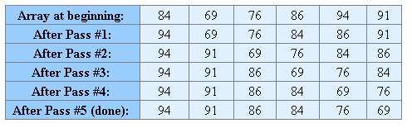
EXCHANGE SORT (Example)
Notes:
just like a bubble sort does. The only difference between the two sorting algorithms is the manner in which they compare the elements.
In some situations the exchange sort is slightly more efficient than its counter part the bubble sort. The bubble sort needs a final pass to determine that it is finished, thus is slightly less efficient than the exchange sort, because the exchange sort doesn’t need a final pass.

Slide 14
Exchange Sort Algorithm
Compare the first pair of numbers (positions 0 and 1) and reverse them if they are not in the correct order
Repeat for the next pair (positions 0 and 2)
Continue the process until all pairs have been checked
Repeat steps 1 through 3 for positions 0 through n - 1 to i (for i = 1, 2, 3, ...) until no pairs remain to be checked
The list is now sorted

Slide 15
Exchange Sort Function for Descending Order
void ExchangeSort() { int i, j; int temp; // holding variable int numLength = num.length( ); for (i=0; i< (numLength -1); i++) // element to be compared { for(j = (i+1); j < numLength; j++) // rest of the elements { if (num[i] < num[j]) // descending order { temp= num[i]; // swap num[i] = num[j]; num[j] = temp; } } } return; }

Slide 16
Sorting by Exchange: Quick Sort
Divide-and-Conquer

Slide 17
QUICK SORT (Basic Ideas)
(Another divide-and-conquer algorithm)
Pick an element, say P (the pivot)
Re-arrange the elements into 3 sub-blocks,
Those less than or equal to (<=) P (the left-block S1)
P (the only element ¡n the middle-block)
Those greater than or equal to (>=) P (the right-block S2)
Repeat the process recursively for the left- and right- sub-blocks Return (quicksort(S1), P,quicksort(S2)}.
That is the results of quicksort(S1), followed by P, followed by the results of quicksort(S2)

Slide 18
QUICK SORT (Basic Ideas)
The main idea is to find the “right” position for the pivot element P
After each “pass”, the pivot element, P, should be “in place”
Eventually, the elements are sorted since each pass puts at least one element (i.e., P) into its final position

Slide 19
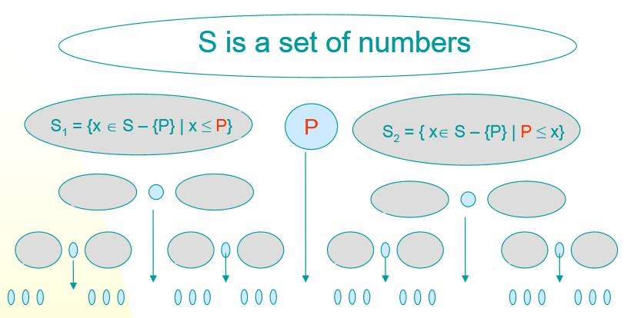
QUICK SORT (Basic Ideas)

Slide 20
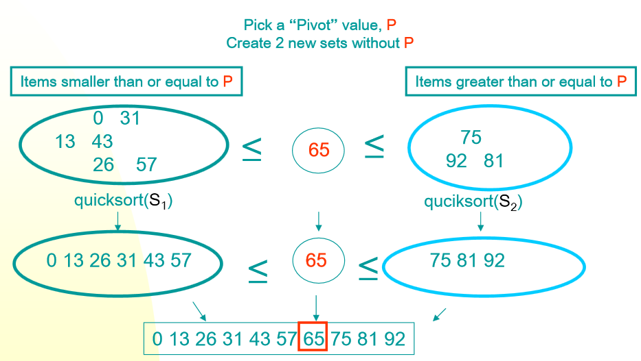
QUICK SORT (Basic Ideas)

Slide 21
Randomized
Quick
Sort
52471326
LT
GT
EQ
5241326
NULL
NULL
LT
EQ
GT
2132
NULL
56
Divide
LT
EQ
GT
LT
EQ
GT
NULL
NULL
232
NULL
NULL
6
LT
EQ
GT
NULL
2
3
6

Slide 22
Randomized
Quick
Sort
7
LT
GT
EQ
4
NULL
NULL
LT
EQ
GT
1
NULL
5
Divide
LT
EQ
GT
LT
EQ
GT
NULL
NULL
2
NULL
NULL
6
LT
EQ
GT
NULL
2
3
7

Slide 23
Randomized
Quick
Sort
7
LT
GT
EQ
4
NULL
NULL
LT
EQ
GT
1
NULL
5
Combine
LT
EQ
GT
LT
EQ
GT
NULL
NULL
223
NULL
NULL
6
8

Slide 24
Randomized
Quick
Sort
7
LT
GT
EQ
4
NULL
NULL
LT
EQ
GT
1223
NULL
56
Combine
9

Slide 25
Randomized
Quick
Sort
7
LT
GT
EQ
1223456
NULL
NULL
Combine
10

Slide 26
Randomized
Quick
Sort
12234567
Combine
11

Slide 27
Randomized Quick Sort
•
The
worst-case
running
time
for
randomized
quick-sort is O(n^2)
•
The
worst
case
happens
if
the
sizes
of
the
subproblems are
not balanced.
•
The
selection
of
the
pivot
element
determines
the sizes of the subproblems. It is thus crucial to
select a `good' pivot.
•
If
the
sizes
of
the
subproblems
is
balanced,
worst-case
running
time
for
randomized
quick-
12
sort is bounded by O(nlog2 n)

Slide 28
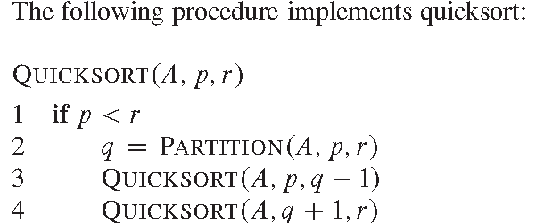
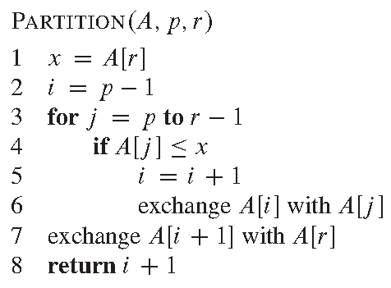
Inline
Quick
Sort
13

Slide 29
Inline Quick Sort
•
•
•
Sorting A[7 1
p = 0, r = 3
p < r
5
3]
–
Partition ( A, 0, 3)
•
•
•
x = A[r] = 3
i = p – 1 = -1 j =0
–
–
j = 1
–
–
A[j] <= x
7 <= 3
•
A[j] <= x
1 <= 3
» i = i + 1 => i = 0
» After swap of A[i] with A[j], i.e., A[0] with A[1]
• A [ 1 7 5 3]
•
j = 2
–
–
A[j] <= x
5 <= 3
14

Slide 30
Inline Quick Sort
•
•
•
Sorting A[1 7
p = 0, r = 3
p < r
5
3]
–
Partition ( A, 0, 3)
•
•
•
x = A[r] = 3
i = 0
After swap of A[i + 1] with A[r], i.e., A[1] with A[3]
• A [ 1 3 5 7]
return i + 1 => i = 1
1
•
q =
–
–
–
Quicksort(A, p, q-1) => (A, 0, 0) <- This function will return on p<r
Quicksort(A, q+1, r) => (A, 2, 3)
15

Slide 31
Inline Quick Sort
•
•
•
Sorting A[1 3 5
p = 2, r = 3
p < r
7]
–
Partition ( A, 2, 3)
•
•
•
x = A[r] = 7
i = p – 1 = 2 – 1 = 1
j =2
– A[j] <= x
– 3 <= 7
» i = i + 1 => i = 2
» After swap of A[i] with A[j], i.e., A[2] with A[2]
• A [ 1 3 5 7]
After swap of A[i + 1] with A[r], i.e., A[3] with A[3]
• A [ 1 3 5 7]
return i + 1 => i = 3
3
•
•
q =
–
16

Slide 32
Inline Quick Sort
•
•
•
Sorting A[1 3 5
p = 2, r = 3
p < r
7]
–
–
–
–
Partition ( A, 2, 3)
q = 3
Quicksort(A, p, q-1) => (A, 2, 2) <- This function will return on p<r
Quicksort(A, q+1, r) => (A, 4, 3) <- This function will return on p<r
17

Slide 33
QUICK SORT

Slide 34
QUICK SORT (Example 2)

Slide 35
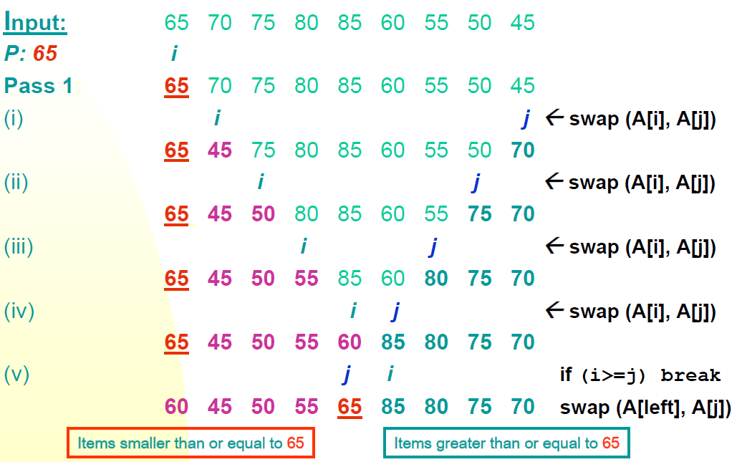
Example 3

Slide 36
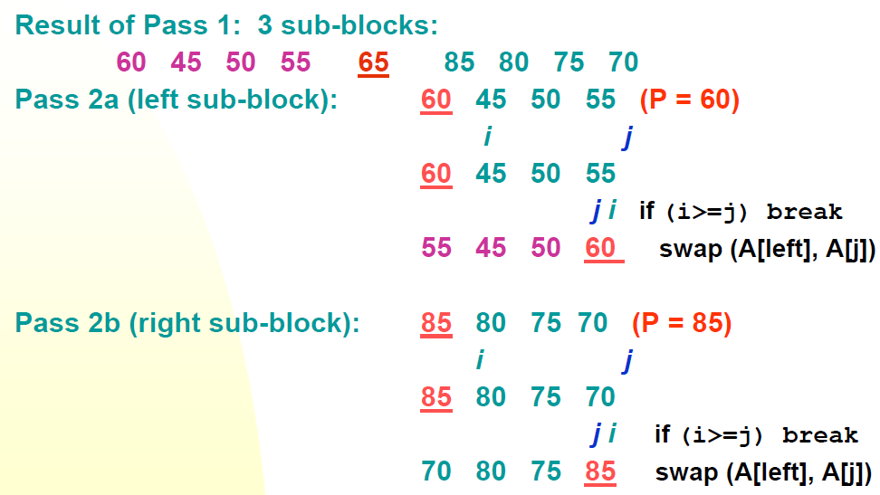
Example 3

Slide 37
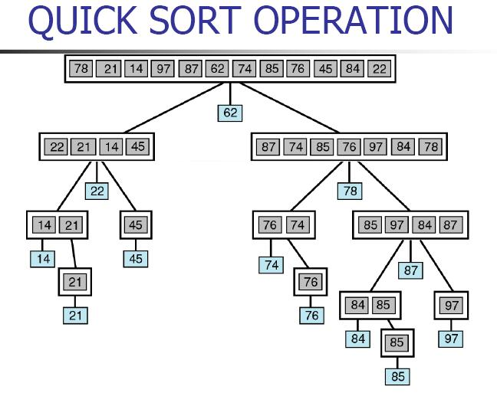
Example 4

Slide 38
ALGORITHM
Let A be a linear array of n elements A (1), A (2), A (3)......A (n), low represents the lower bound pointer and up represents the upper bound pointer. Key represents the first element of the array, which is going to become the middle element of the sub-arrays.
1. Input n number of elements in an array A
2. Initialize low = 0, up = n , key = A[(low + up)/2]
3. Repeat through step 8 while (low < = up)
4. Repeat step 5 while(A [low] > key)
5. low = low + 1
6. Repeat step 7 while(A [up] < key)
7. up = up–1
8. If (low < = up)
(a) Swap = A [low]
(b) A [low] = A [up]
(c) A [up] = swap
(d) low=low+1
(e) up=up–1
9. If (1 < up) Quick sort (A, 1, up)
10. If (low < n) Quick sort (A, low, n)
11. Exit

Slide 39
QUICK SORT (Program)
int partition(int arr[], int left, int right)
{
int i = left, j = right;
int tmp;
int pivot = arr[(left + right) / 2];
while (i <= j) {
while (arr[i] < pivot)
i++;
while (arr[j] > pivot)
j--;
if (i <= j) {
tmp = arr[i];
arr[i] = arr[j];
arr[j] = tmp;
i++;
j--;
}
};
return i;
}

Slide 40
QUICK SORT (Program)
void quickSort (int arr[], int left, int right) {
int index = partition(arr, left, right);
if (left < index - 1)
quickSort(arr, left, index - 1);
if (index < right)
quickSort(arr, index, right);
}

Slide 41
Picking the Pivot
A “good” pivot is one that creates two even sized partitions
Median will be best, but finding median could be as tough as sorting itself
How about choosing the first element?
What if array already or nearly sorted?
Good for a randomly populated array
How about choosing a random element?
Good in practice if “truly random”
Still possible to get some bad choices
Requires execution of random number generator

Slide 42
Picking the Pivot
Best choice of pivot
Median of array
But median is expensive to calculate
Next strategy: Approximate the median
Estimate median as the median of any three elements
Median = median {first, middle, last}
Has been shown to reduce
running time (comparisons) by 14%
8 1 4 9 0 3 5 2 7 6
will result in
1 0 3 2 4 8 9 5 7 6
pivot
8 1 4 9 0 3 5 2 7 6
will result in
1 4 0 3 5 2 6 8 9 7

Slide 43
Running time analysis
The advantage of this quick sort is that we can sort “in-place”, i.e., without the need for a temporary buffer depending on the size of the inputs.(merge sort)
Partitioning Step: Time Complexity is θ(n)
Recall that quick sort involves partitioning, and 2 recursive calls
Thus, giving the basic quick sort relation:
T(n) = θ(n)+ T(i) + T(n-i-1) = cn+ T(i) + T(n-i-1)
where I is the size of the first sub-block after partitioning
We shall take T(0) = T(1) = 1 as the initial conditions

Slide 44
Running time analysis
Worst-Case (Data is sorted already)
When the pivot is the smallest (or largest) element at partitioning on a block of size n, the result
yields one empty sub-block, one element (pivot) in the “correct” place and one sub-block of size (n-1)
takes θ(n) times
Recurrence Equation:
T(1) = 1
T(n) = T(n-1) + cn
Solution: θ(n2)
Worse than Mergesort!!!

Slide 45
Running time analysis
Best case:
The pivot is in the middle (median) (at each partition step), i.e. after each partitioning, on a block of size n, the result
yields two sub-blocks of approximately equal size and the pivot element in the “middle” position
takes n data comparisons
Recurrence Equation becomes
T(1) = 1
T(n) = 2T(n/2) + cn
Solution: θ(n logn)
Comparable to Merge sort!!

Slide 46
So the trick is to select a good pivot
Different ways to select a good pivot
First element
Last element
Median-of-three elements
Pick three elements, and find the median x of these elements. Use that median as the pivot
Random element
Randomly pick a element as a pivot

Slide 47
Sources used
Lectures by Mr. Mohammad Asad Abbasi

